Slide 1

Makeathon 2023
Idea Submission

Slide 2
TEAM NAME AND MEMBER DETAILS
TEAM NAME : CodeBusters
MEMBERS -
Shivani Singh
Shruti Pragya
Valleri Jayal
Sagam Reddy Nanditha
THEME : ML-BASED FRAUD DETECTION

Slide 3
PROBLEM STATEMENT
The problem statement chosen for this project is to predict fraudulent activities such as fake news, identity theft which are serious problems for businesses and individuals alike, using machine learning models.
Fake news on different platforms is spreading widely and is a matter of serious concern, as it causes social wars and permanent breakage of the bonds established among people. A lot of research is already going on focused on the classiﬁcation of fake news.
The main objective is to detect the fake news, which is a classic text classiﬁcation problem with a straightforward proposition. It is needed to build a model that can differentiate between “Real” news and “Fake” news.The ability to draw users to media organizations' websites is required to create online advertising revenue. As a result, it is vital to recognize fake news. Machine learning can help in detecting the fake news . Through the use of machine learning these fake news can be detected easily and automatically. Once someone will post the fake news, machine learning algorithms will check the contents of the post and will detect it as a fake news.
Machine learning classiﬁers are used for different purposes and these can also be used for detecting the fake news. The classiﬁers are ﬁrst trained with a data set called training data set. After that, these classiﬁers can automatically detect fake news.

Slide 4
SOLUTION

Slide 5
Using this model, a tool is implemented for detecting Frauds. we have used transformers .At high level, transformer model consists of a series of layers, each of which includes a self-attention mechanism and a feed-forward neural network.
The self-attention mechanism allows the model to attend to different parts of
the input sequence to better capture the relationships between different words
Or tokens. The feedforward network then applies a non-linear transformation to
the output of the self-attention layer. One of the key benefits of transformers is
their ability to process entire input sequences at once, rather than one word or
token at a time as in traditional recurrent neural networks (RNNs).This makes them much faster and more efficient, and allows them to capture longer-term dependencies in the input.

Slide 6
The idea behind attention masks is to provide a way for the model to focus its attention on relevant information and ignore irrelevant or noisy inputs. In an attention mask, each element in the input sequence is assigned a weight between 0 and 1, which indicates how much attention the model should pay to that element. Elements with higher weights are considered more important, while elements with lower weights are considered less important. The attention mask is used during the decoding process to determine which hidden states should be attended to at each time step. There are several types of attention masks, including self-attention masks and cross-attention masks. Self-attention masks are used to attend to different parts of the input sequence, while cross-attention masks are used to attend to different parts of two input sequences

Slide 7
we have used Passive-Aggressive Classifier which is a type of linear classification algorithm used in machine learning. It belongs to the family of online learning algorithms, meaning that it can update its model parameters incrementally as new data arrives. The Passive-Aggressive Classifier is particularly useful in scenarios where the data is streaming in and the model needs to adapt to changes quickly. The algorithm is especially effective when dealing with large-scale datasets, as it can learn from one example at a time and does not require storing the entire dataset in memory. The basic idea behind the algorithm is to update the model parameters in a way that minimizes the loss function while also enforcing a margin of separation between the positive and negative examples. This margin is controlled by a hyperparameter called the ”C” parameter, which determines the aggressiveness of the updates. The Passive-Aggressive Classifier is a popular choice for Fraud Detection due to its ability to adapt to new data quickly and handle large- scale and streaming data.

Slide 8
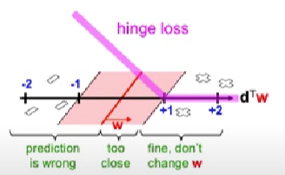
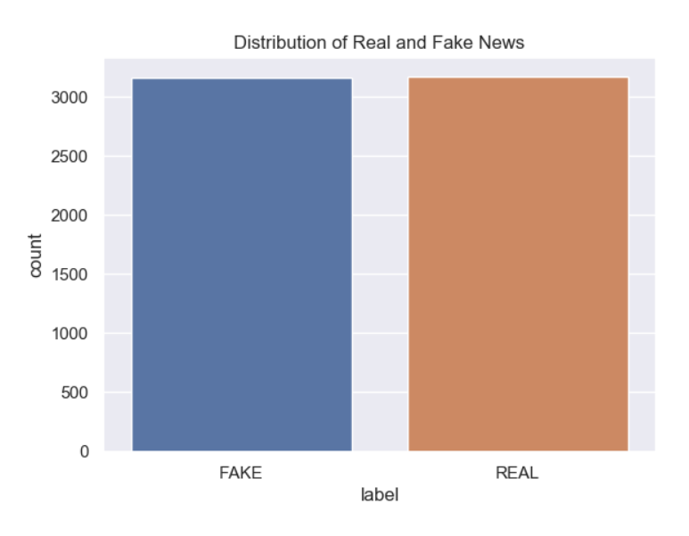
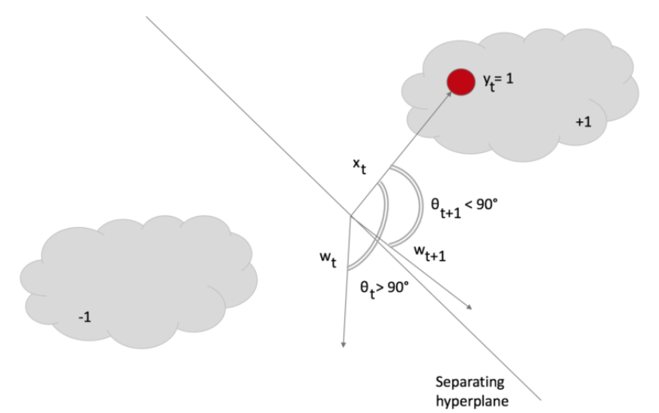
METHODOLOGY
1. We will collect a set of data marked as factual or false. We have to build our own dataset here as there is not a single dataset available that is in the Indian context or uses languages other than English.
2. Features must be extracted from the text data through methods such as bag of words, TF-IDF, or word embedding.
3. We will train a machine-learning model using the extracted features and the labeled data.
4. Fine-tuning and evaluation of the model can be done through cross-validation, confusion matrix, precision, recall, and f1-score.
5. The model will then be tested with unseen data and any necessary adjustments can be made.
We carry out the above steps for Hindi and English Language data sets. Finally, the interface is built on Streamlit which is an open-source Python library that makes it easy to build interactive web applications for data science and machine learning. One of the key features of Streamlit is its ability to automatically update the application in real-time as we make changes in the code. This makes it easy to experiment and iterate quickly, without having to restart the application or reload the browser.

Slide 9

SOCIETAL IMPACT/ NOVELTY
FUTURE SCOPE
1. Enhanced Trust and Confidence: Fraud can erode trust and confidence in financial institutions, e-commerce platforms, and other systems that involve transactions. Organizations can demonstrate their commitment to security and protect their customers' interests by implementing effective fraud detection systems. This, in turn, fosters trust and confidence in society, encouraging individuals and businesses to participate in economic activities without the fear of falling victim to fraud.
2. Reduced Financial Losses: Fraud detection systems have a significant societal impact by mitigating financial losses for individuals, businesses, and governments. By minimizing financial losses, fraud detection systems help protect individuals' savings, safeguard businesses' assets, and reduce the burden on government resources.
1. Deterrence and Prevention: Fraud detection systems act as a deterrent to potential fraudsters. Knowing that their activities are being monitored and swiftly detected, individuals with malicious intent are less likely to engage in fraudulent behavior. This helps maintain the integrity of financial systems and markets.
2. Efficient Resource Allocation: Fraud detection systems streamline the process of identifying and investigating fraudulent activities, enabling efficient allocation of resources to genuine transactions and legitimate activities. By reducing the time and effort required for manual fraud investigations, these systems free up resources that can be utilized for societal development, such as improving public services, infrastructure, healthcare, or education.

Slide 10

THANK YOU

